Slide 1
Toward Constraint Compliant Planning and Goal Formulation
Steven Jones, Robert Wray
(steven.jones@cic.iqmri.org)
Soar Workshop 2024
integratedcognition.ai
Accepted for presentation at ACS2024.
Preprint: https://arxiv.org/abs/2405.12862

Slide 2
Cognitive Capabilities for Constraint Compliance
Part of a broader computational-level analysis (in the sense of Marr) of constraint compliance: Wray, R. E., Jones, S., & Laird, J. E. (2023). Computational-level Analysis of Constraint Compliance for General Intelligence. Proceedings of the 2023 Artificial General Intelligence (AGI) Conference.

Slide 3
Cognitive Capabilities for Constraint Compliance
Achieve a task, sensitive to constraints in the world
Part of a broader computational-level analysis (in the sense of Marr) of constraint compliance: Wray, R. E., Jones, S., & Laird, J. E. (2023). Computational-level Analysis of Constraint Compliance for General Intelligence. Proceedings of the 2023 Artificial General Intelligence (AGI) Conference.
Notes:
Didn’t you do this already? What about last talk? Well, we kinda hard-coded strategies for how to perform a patrol for the grounding investigation. So, for this talk, what if the agent had to figure out how to do the patrol itself, sensitive to some constraints?

Slide 4
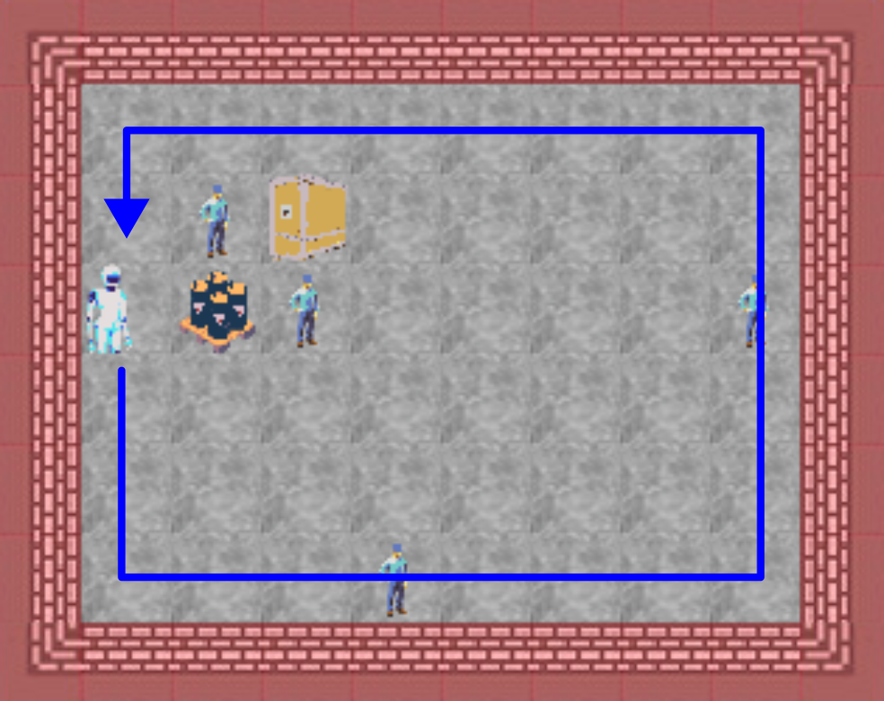
Experimental Task: Patrol
Check the perimeter of the warehouse:
achieving a minimum threshold of coverage for the wall-adjacent cells
without exceeding your resources for movement

Slide 5
Agent reasoning to achieve Patrol
A* search
heuristic:
Max(Distance to start, Number of Border Cells left to cover)

Slide 6
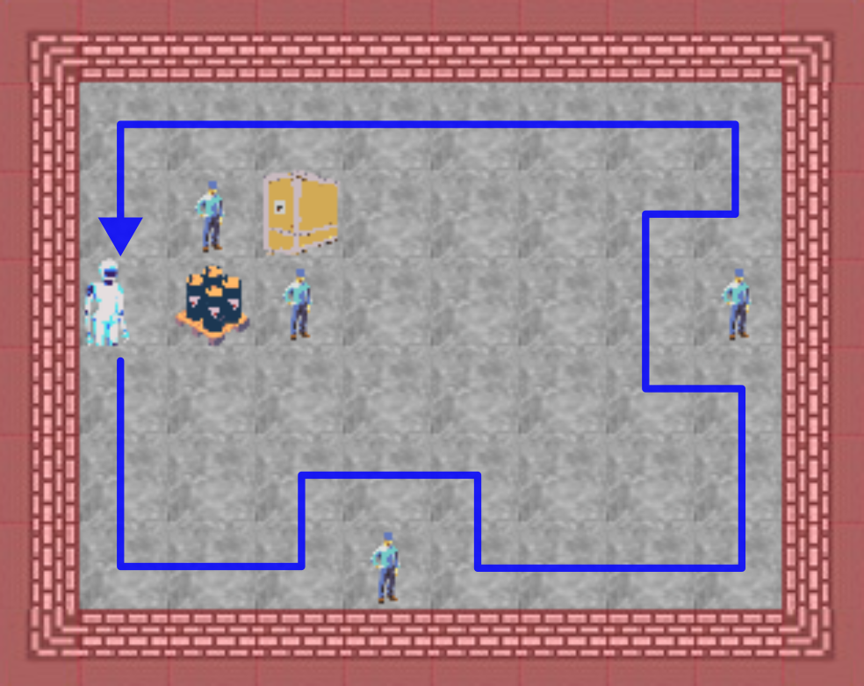
A normative constraint: Avoid the personal space of others
Utilitarianism:
Entering someone’s personal space is considered a cost
Deontology:
Not entering someone’s personal space is considered a (prohibitive) duty
Notes:
The norm is to stay out of someone’s space to avoid the potential for disrupting them.

Slide 7
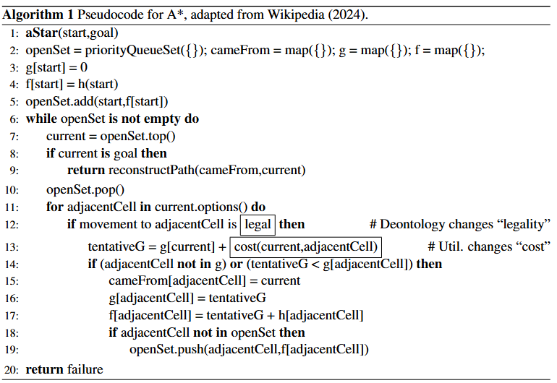
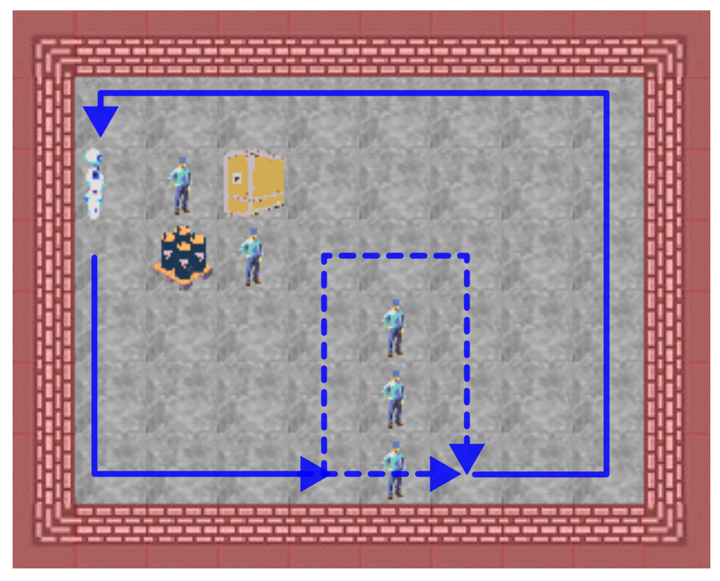
Applying constraints to A*
Notes:
With the heuristic we described, the agent will choose paths that hug the wall when using traditional A*. However, this algorithm provides us the potential to explore potential ways that constraints can influence task planning. In A*, we want to see a sensitivity to people being present on the map, but we also want to maintain a sensitivity to task completion. In this example figure, if we have either a prohibition on movement or a high enough cost (the same kind of cost used in A* search already), but associated with entering a people-occupied cell, then we’ll see an agent still complete the task, but move around people, even though it might be a more expensive path outside of the presence of the norm. This is the main idea behind our approach, and now I’m going to go into more detail.

Slide 8
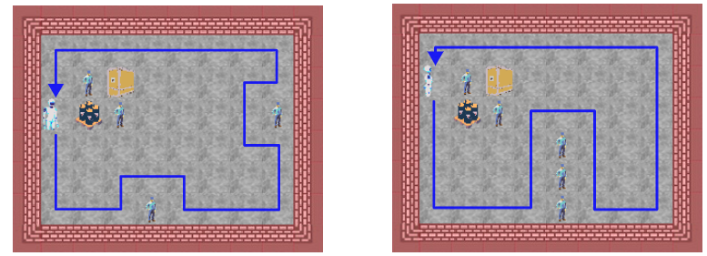
Deontological Behavior

Slide 9
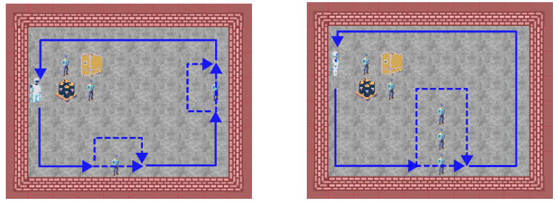
Utilitarian Behavior

Slide 10
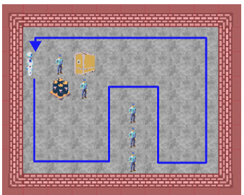
A Need for Metacognitive Monitoring
Deontology: What if I’ll run out of battery and fail to complete the patrol?
Utilitarianism: Why consider the constraint if I won’t ever move around people?

Slide 11
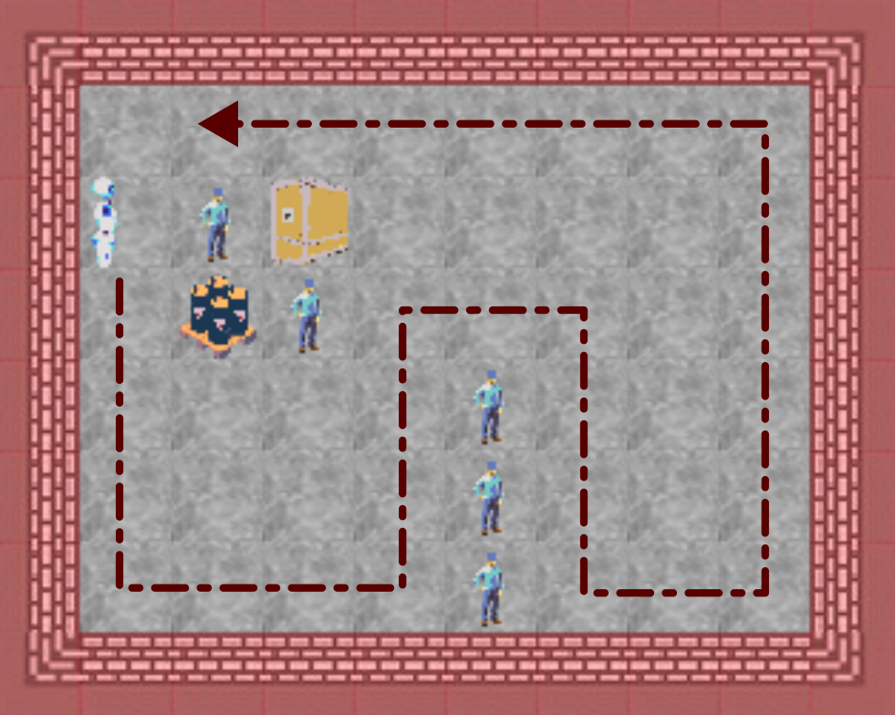
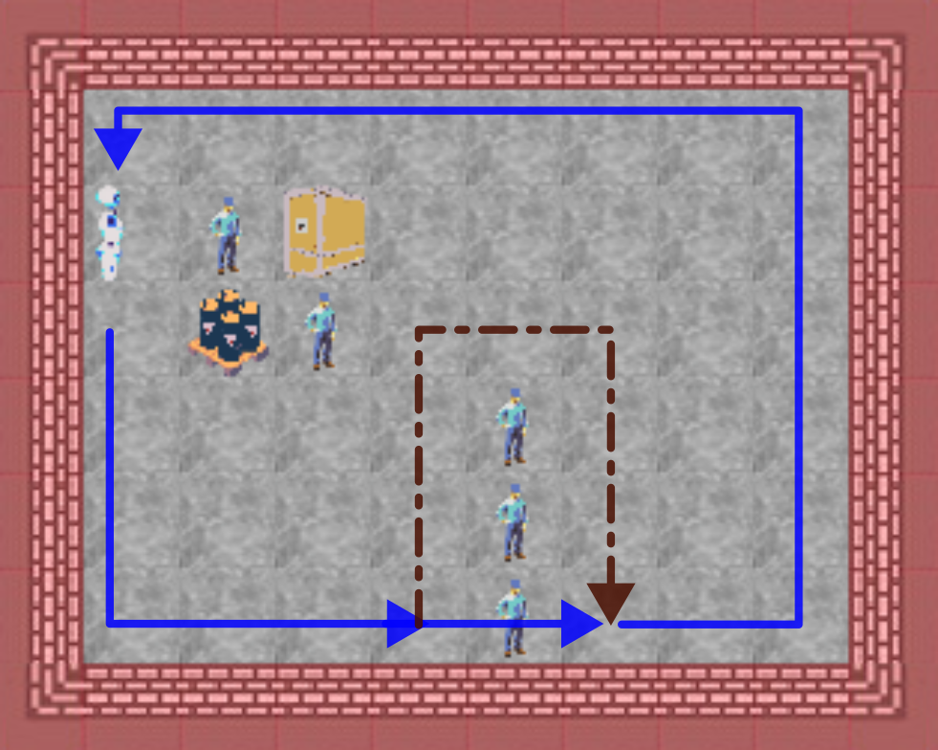
Deontology + Metacognition
If every path that avoids people leads to failing patrol, increment the number of people you are allowed to potentially disrupt
Tests “exhaustion-failure” in Soar’s default rules
becomes

Slide 12
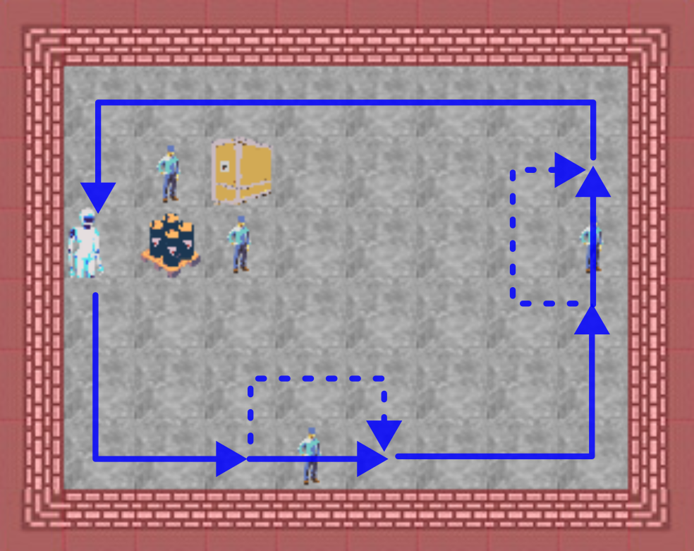
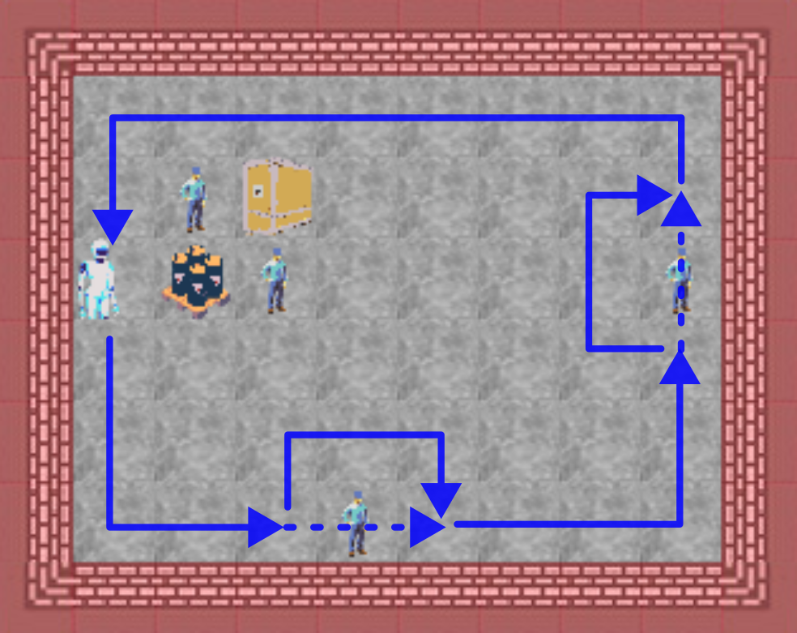
Utilitarianism + Metacognition
If there is plenty of spare movement available and the encoded cost to entering an occupied cell is low (< 4) and the current plan is to disrupt people, replan with higher (5) cost
What would be “success” in default rules now has above tests
becomes

Slide 13
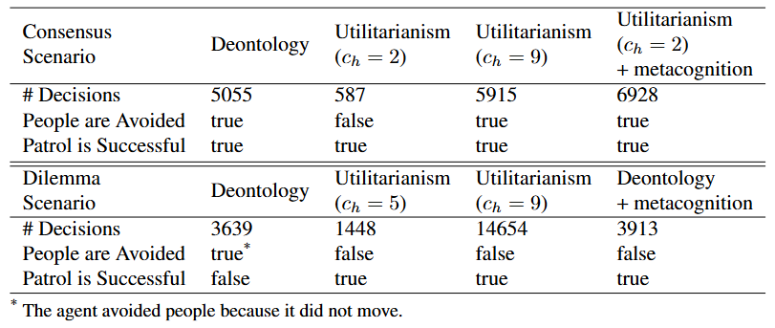
Summary Results from Exploration

Slide 14
Building on the Initial Exploration
Mix of different classes of constraints
Hard, soft
Physical, safety, normative
Larger maps (more situations for constraints and task to interact)
More “realistic” experimental conditions
Limited observation
Limited time for planning (“anytime” solutions)
Prior “familiarity” with the overall domain (training/curriculum)
Other variations in representation of constraints (e.g., individual “distance” costs for different specific individuals)
Refinement of normative reasoning
Additional frameworks (e.g., “virtue ethics”)
Metacognitive decision making for choosing a framework to represent norms

Slide 15
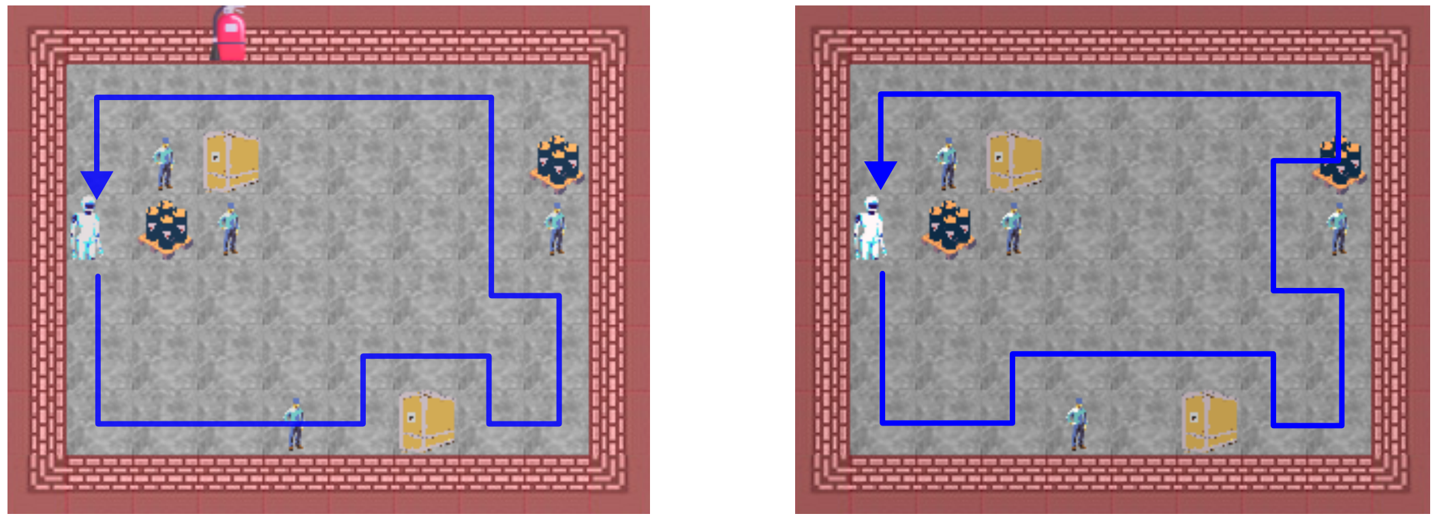
Balancing among several constraints and task performance

Slide 16
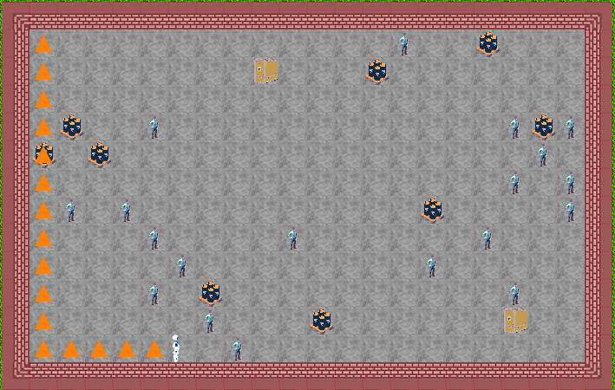
Larger Maps Present More Complex Situations

Slide 17
Nuggets and Coal
Coal
Nuggets
Early investigation with many variables not yet explored
Default rule A* planning chunks have limited transfer
Grid world domain (useful for exploration but not compelling)
Pattern of integrating norm knowledge into already-functioning task cognition works
Choice of different ethical frame does matter
Grounding code creates general chunks

Slide 18
Acknowledgements
This work was supported by the Office of Naval Research, contract N00014-22-1-2358. The views and conclusions contained in this document are those of the authors and should not be interpreted as representing the official policies, either expressed or implied, of the Department of Defense or Office of Naval Research. The U.S. Government is authorized to reproduce and distribute reprints for Government purposes notwithstanding any copyright notation hereon.

Slide 19
Additional Forms of Ethics as Cognitive Architecture Knowledge??
Virtue Ethics
Exemplar – “case-based” mimicry of virtuous agent
Trait – attempting to maintain virtuous autobiographical memory features
Rule utilitarianism
Satisficing/Approximating utilitarianism with lower computational load

